Slide 1
Error 404: Name Not Found
SmartMart
José de Jesús Hernández Vázquez 22550025
Feat (Felix Ulisses Mancinas Zamora) 22550029
Feat (Jesús Iván García Delgado) 22550015
Feat (Sergio Eduardo Lastiri Torres) 22550031

Slide 2
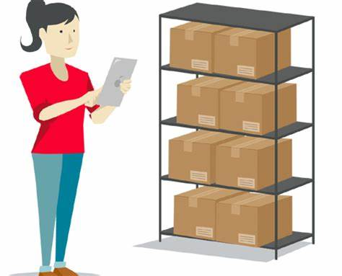
Justification
Develop a software which allow users to gain access to the inventory of the shop in real time, giving them the option to take better decisions about their shopping.

Slide 3

Objectives
General:
Develop inventory and order management software for grocery stores in order to efficiently optimize operational processes and improve the user experience.

Slide 4
Specific objectives:
- Effective Inventory Management.
- Order automation.
- Intuitive & User-Friendly Interface.
- Supplier Management.
- Smartphone integration.
- Security and compliance.
- Technical support and continuous updates.

Slide 5

Effective Inventory Management.
Implement a real-time inventory tracking system
Set up automatic alerts to notify you of low stock levels and upcoming expiration dates.

Slide 6
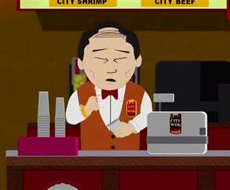
Order automation.
Facilitate automatic order generation based on inventory levels and historical demand.

Slide 7




Intuitive & User-Friendly Interface.
Design an intuitive user interface that allows users, even with little tech experience, to easily use the software.

Slide 8
Supplier Management.
Implement a module to manage supplier information, including contact details, transaction history, and agreed prices.

Slide 9

Smartphone integration.
Develop mobile applications compatible with iOS and Android platforms so that users can access the system remotely.

Slide 10
Security and compliance
Implement security measures to protect sensitive information, such as inventory, vendor, and customer data.

Slide 11
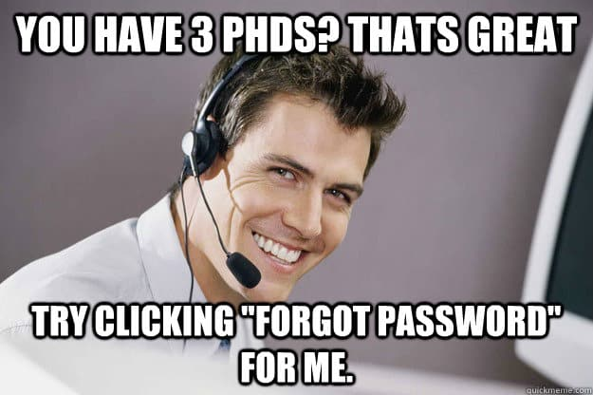
Technical support and continuous updates.
Offer an efficient technical support system to resolve issues quickly and offer assistance in the initial implementation, as well as our customer service contact

Slide 12
Issues
The flexibility in the development approach has allowed us to not only solve the initial challenges effectively, but also incorporate elements that not only improve functionality, but also elevate the user experience to higher levels.

Slide 13

While acknowledging that there are still specific areas that require refinement, we are encouraged by the remarkable progress we have made so far.

Slide 14
Procedures
Taking into account the functions of the program, we have that it can perform the following:
Succesfull connection to a data base
Login
Data base management (inventory management)
Order notification
Order confirmation

